Slide 1

AS2 PROGRAMMING
Ezekiel & Jeriel
01

Slide 2
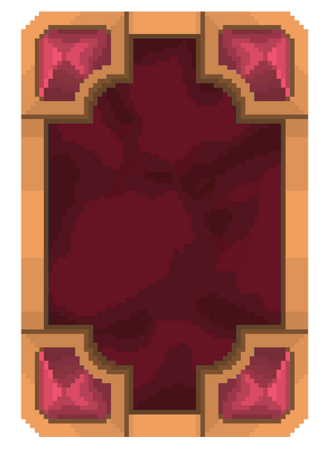
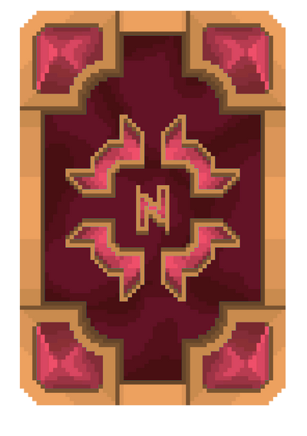
AS2 PROGRAMMING
Ezekiel & Jeriel
02
CARD MEMORY
We are using SDL2 to help create a window to render objects. It also allows user to input mouse movements and inputs. It also allows the game to play audio which we will be using when flipping the cards.
Also, we used SDL2 image library which allows us to add external graphics for our game.
FRONT FACE
BACK FACE
Front face of the card symbol will be placed in the middle
Back face of the card, this is what user will see when the card is not flipped

Slide 3
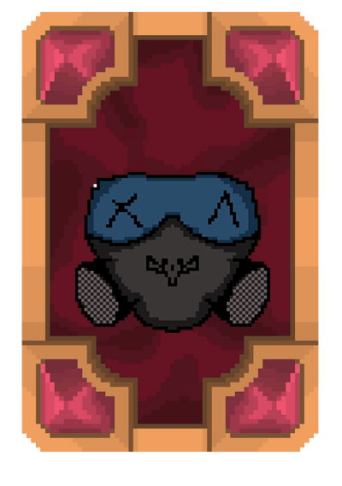

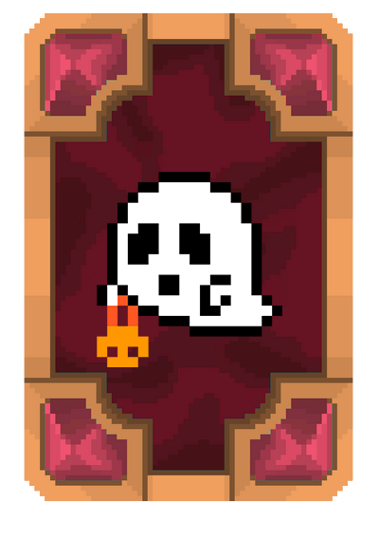
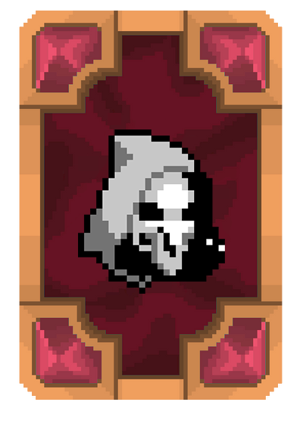
AS2 PROGRAMMING
Ezekiel & Jeriel
02
It also allows users to choose what difficulty they would like to play there are 3 levels.
Users are able to pause at any point during the game.
CARD MEMORY
The objective of a card memory game is to match pairs of cards by remembering their positions and symbols.
The game continues until all pairs have been matched.

Slide 4




AS2 PROGRAMMING
Ezekiel & Jeriel
02
Level 1: 1min 00secs
Level 2: 1min 30secs
Level 3: 2min 00secs
CARD MEMORY
The cards will all be randomized for each level.
The game will also consist of a timer countdown which allocates a fixed amount of time they need to finish the level.

Slide 5
AS2 PROGRAMMING
Ezekiel & Jeriel
03
USUAGE OF CODES
Functions: Used functions to store frequently used codes.
E.g.
Update which checks for any boolean changes.
Render which displays the images/design.
init to initialize any variables
Handle events that handles inputs from user.
Arrays: 2D dimensional arrays with pointers including boolean and specified class dynamic arrays.
Pointers: Used pointers to create a new variable in a struc("gameObjects")
Loop control: Looping the gameplay, using loops to create the number of cards displayed on the screen.
Strings: Used for struc, and used to point to texture files.

Slide 6
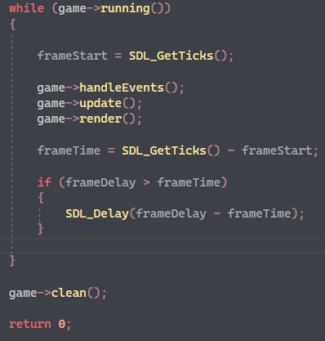
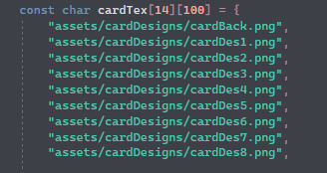
AS2 PROGRAMMING
CODES
Ezekiel & Jeriel
04

Slide 7
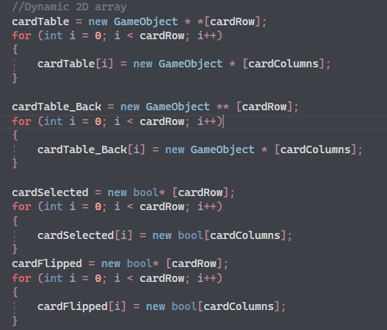
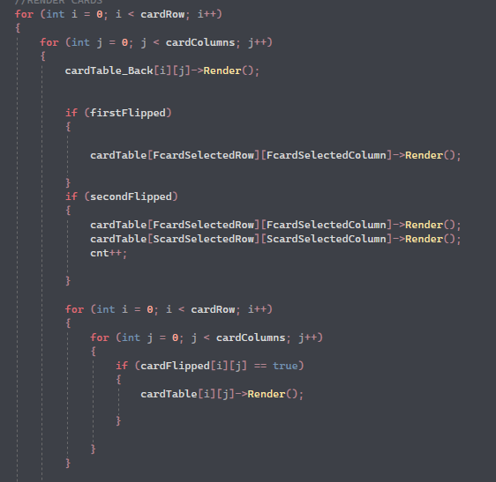
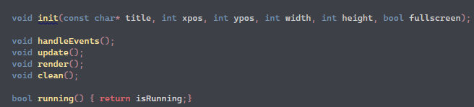
AS2 PROGRAMMING
CODES
Ezekiel & Jeriel
04

Slide 8
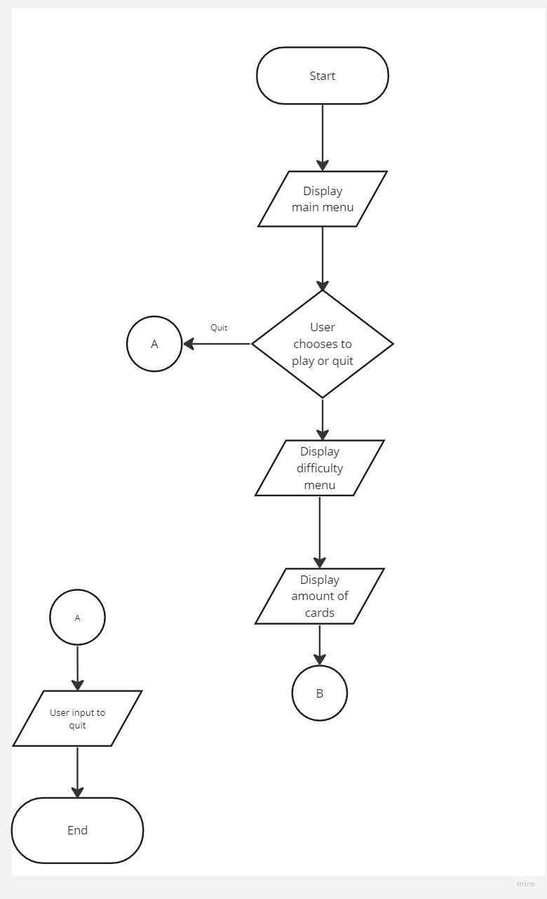
AS2 PROGRAMMING
Ezekiel & Jeriel
05
FLOW CHART

Slide 9
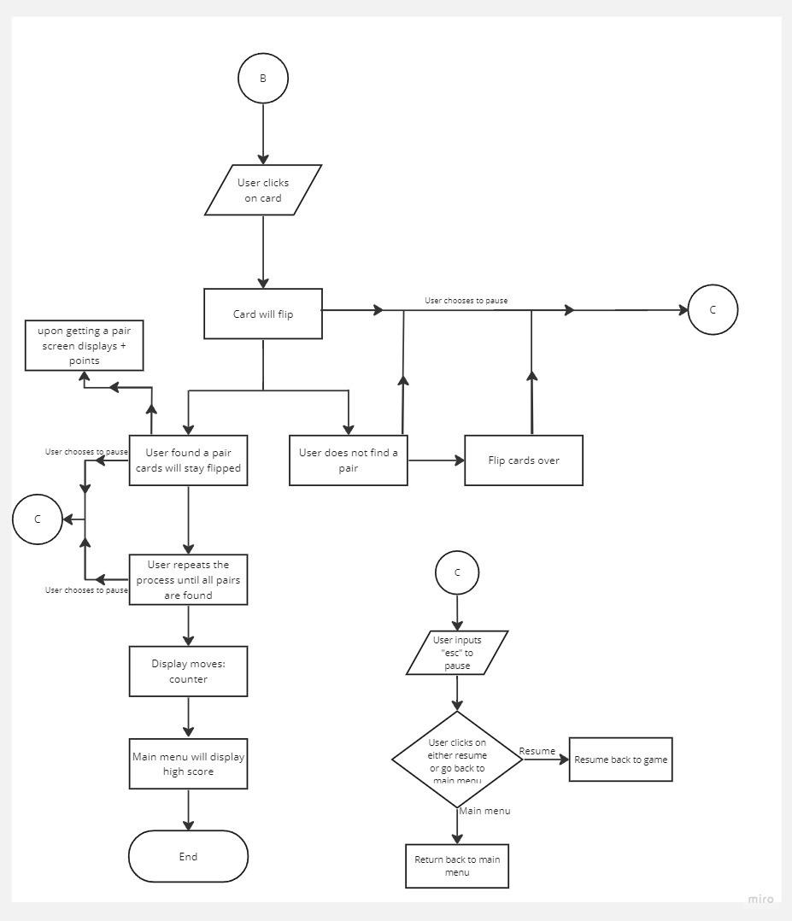
AS2 PROGRAMMING
Ezekiel & Jeriel
05
FLOW CHART

Slide 10






BUTTONS
When user clicks on a difficulty button, the box will be highlighted with a white outline.

Slide 11
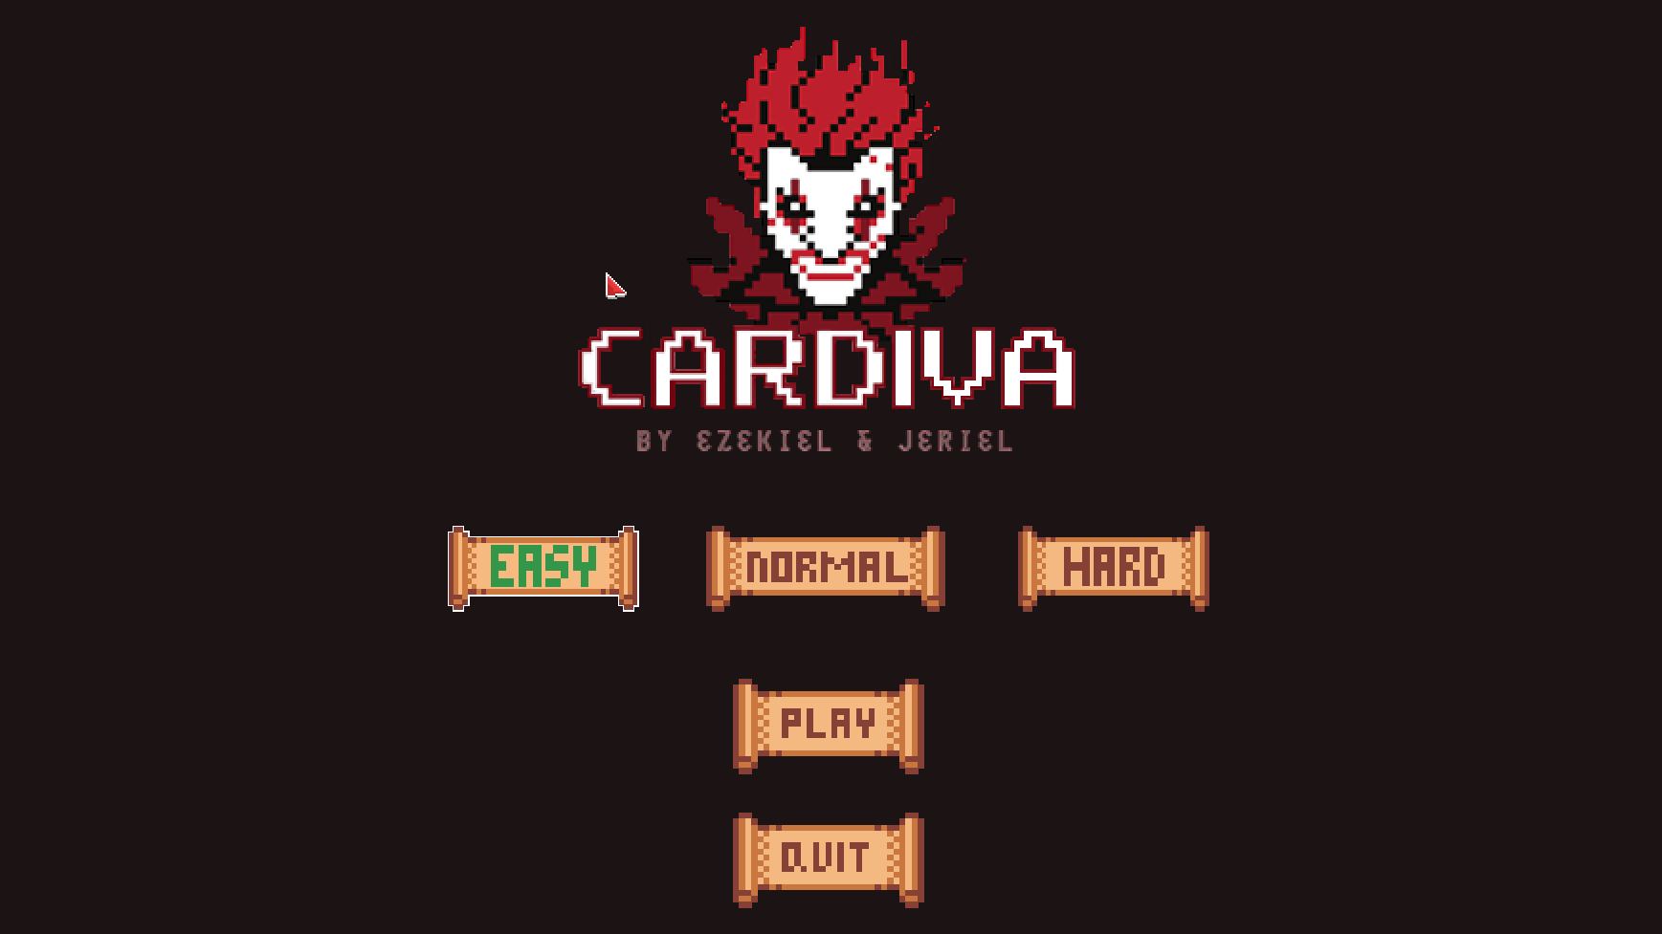
MAIN MNU

Slide 12

PAUSE MENU

Slide 13
https://drive.google.com/drive/folders/1Rjn7c3rSmczOCTIKJvhG5Vn1ZJtbH5jt?usp=sharing
LINK TO DRIVE
Here's a link to the Google drive if you want to check the designs out.

